Slide 1
GROUP4
HRISHIKESH
RUSHABH
AMOL
SAIPRIYA
PRATHYUSHA
BHAVYASHREE

Slide 2
Device Management
Device management is to manage different I/O devices and files, process in the systems.

Slide 3
Device Drivers
Device driver’s are called as “Black Boxes” that make a particular piece of hardware respond to the programming interface.
The role of the device drivers is that the application activities are performed by a standard call’s which are independent to the specific driver, mapping those calls to the specific driver and act on it is the role of the device driver.
They can be loaded at any into the kernel.

Slide 4
Device File and Naming Convention
Device files allow user programs to access hardware devices on the system through the kernel.
They are not "files" per se, but look like files from the program's point of view: you can read from them, write to them, mmap() onto them, and so forth.
When you access such a device "file," the kernel recognizes the I/O request and passes it a device driver, which performs some operation, such as reading data from a serial port, or sending data to a sound card.

Slide 5
Location of Device File
Device files are located in the directory /dev on nearly all Unix-like systems.
When using ls –l to list device files in /dev,
brw-rw---- 1 root disk 3, 0 May 19 1994 /dev/hda
Create device file
mknod -m permissions name type major minor
Remove device file
rm /dev/bogus

Slide 6
Piping
Every program has three data stream’s connected to it .
Piping is the means by which we connect these streams between programs and files to direct data in useful ways.
It is used to send data from one program to another and it can be achieved using “|” operator to pipe between two programs.

Slide 7
What is IRQ’S?
It is a signal sent from a device to a processor indicating that to process a request.
Linux kernel interrupt processing is divided into two parts:
1.TOP HALF
2.BOTTOM HALF
Interrupt request can be handled by calling irq()

Slide 8
INTERRUPT HANDLING MECHANISM
TOP HALF:
It communicates with the hardware and set a flag in kernel memory.
Bottom Half:
The “bottom half” does other necessary processing, for example copying data into process memory, updating kernel data structures, etc. It can take its time and even block waiting for some other part of the system since it runs with interrupts enabled.

Slide 9
Device file has two types
Block Device: is one with which the Driver communicates by sending entire blocks of data.
Examples for Block Devices: hard disks, USB cameras, Disk-On-Key.
Character Device: is one with which the Driver communicates by sending and receiving single characters (bytes, octets).
Examples for Character Devices: serial ports, parallel ports, sound
cards.

Slide 10
A character device driver work with stream of bytes.
Character devices can be compared to normal files.
The main difference between normal files and character files is the normal files can always move back and forth , whereas the character devices are just data channels.
Character devices can only access Sequentially.
Example's: Serial port, /dev/console

Slide 11
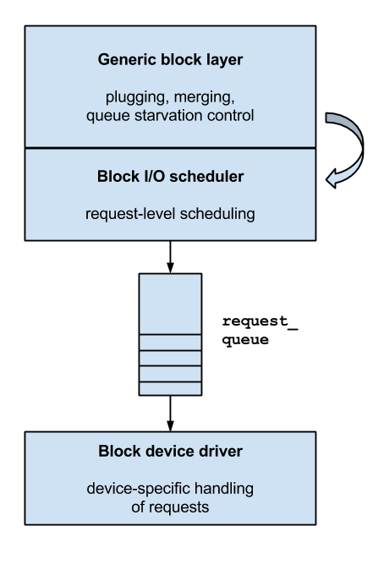
Block Devices
Block special files or block devices: provide buffered access to hardware devices, and provide some abstraction from their specifics.

